Slide 1
About the teacher
KUL 4.0 IIOT
Jan van Deventer

Slide 2
Jan van Deventer
Associate Professor in Cyber Physical Systems (CPS)
What are CPS?
Education and career path
Why teach this course?

Slide 3
CPS and IoT
From Wikipedia,
A cyber physical system (CPS) is a computer system in which a mechanism is controlled or monitored by computer-based algorithms.
Examples of CPS include smart grid, autonomous automobile systems, medical monitoring, industrial control systems, robotics systems, and automatic pilot avionics.
CPS is also similar to the Internet of Things (IoT), sharing the same basic architecture; nevertheless, CPS presents a higher combination and coordination between physical and computational elements.

Slide 4
CPS as a Subject
CPS involves transdisciplinary approaches, merging theory of cybernetics, mechatronics, design and process science. The process control is often referred to as embedded systems. In embedded systems, the emphasis tends to be more on the computational elements, and less on an intense link between the computational and physical elements.

Slide 5



Education Path
High School (1983), The Stony Brook School, NY
B.S. Physics (1987), Hope College, MI
M.S. Mechanical Engineering (1989), Ann Arbor, MI
Ph.D. Electrical Engineering (2001), Luleå, Sweden

Slide 6
Career Path
Phlebotomist (UofM),
Cancer research (UCI),
System Engineer, Automotive Active Safety (Kelsey-Hayes),
Ultrasonic Densitometer development (LTU),
Lecturer (LTU):
Measurements
Automotive Systems
Project courses

Slide 7

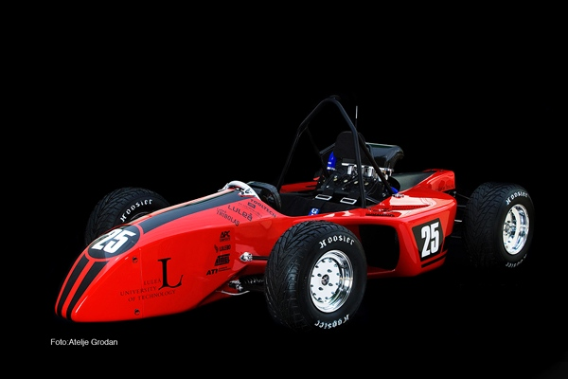
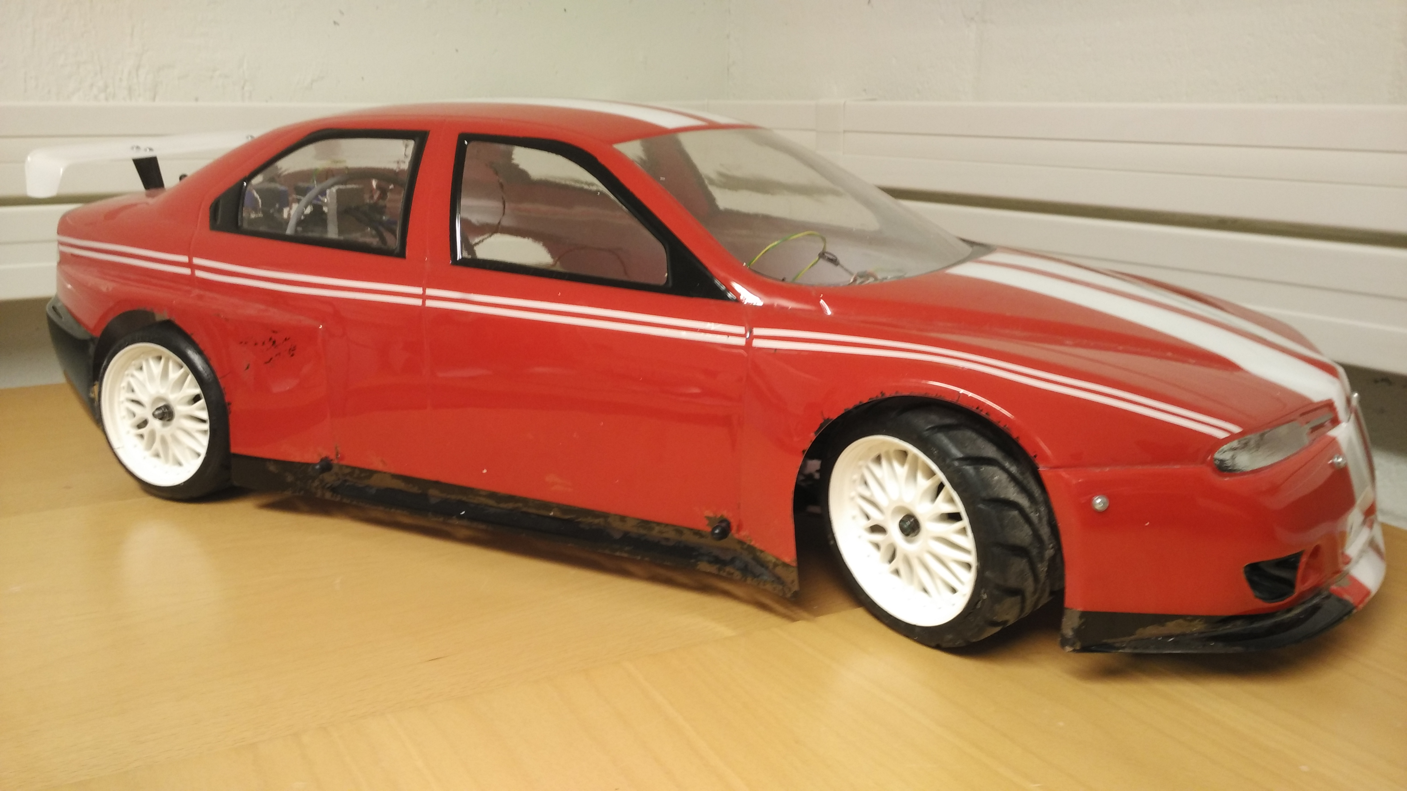
Race Cars with Networks

Slide 8
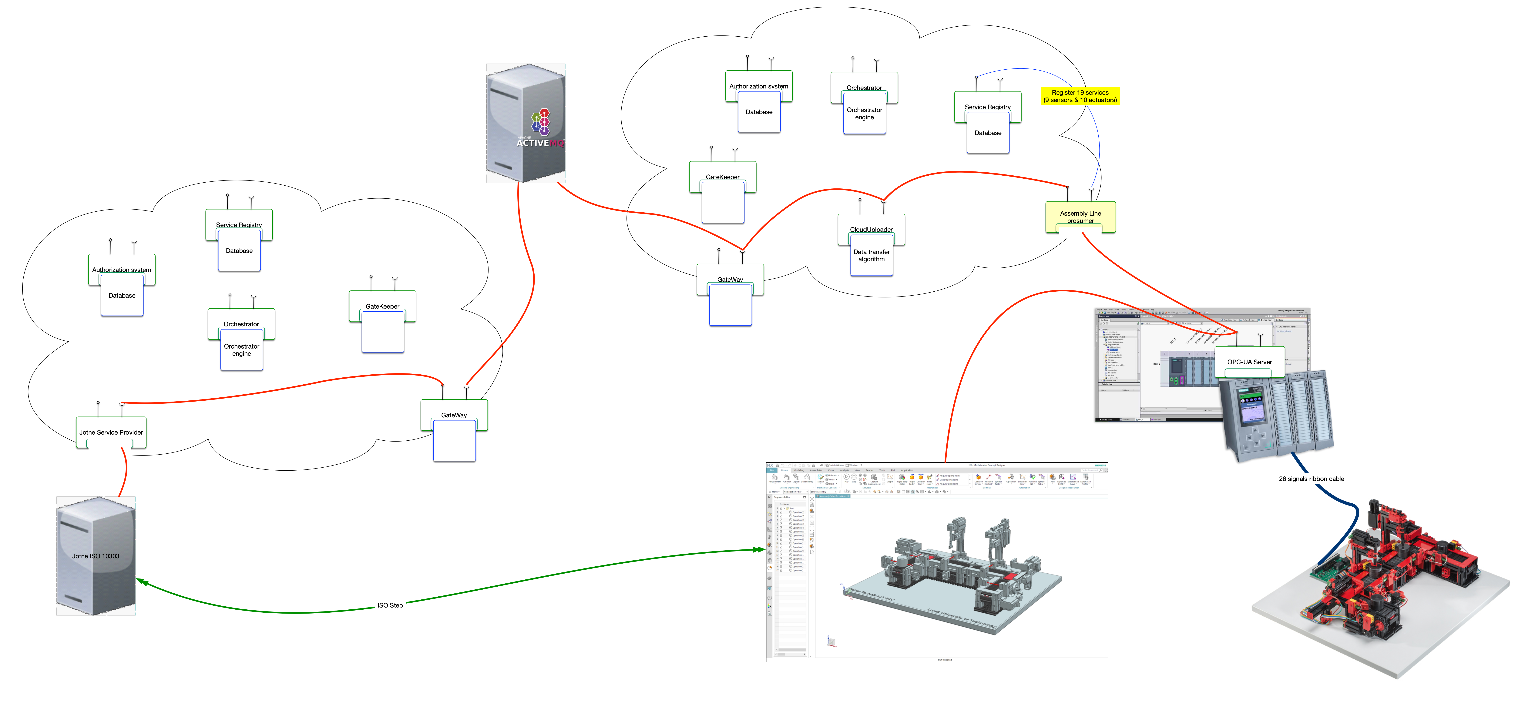
Manufacturing with Networks

Slide 9
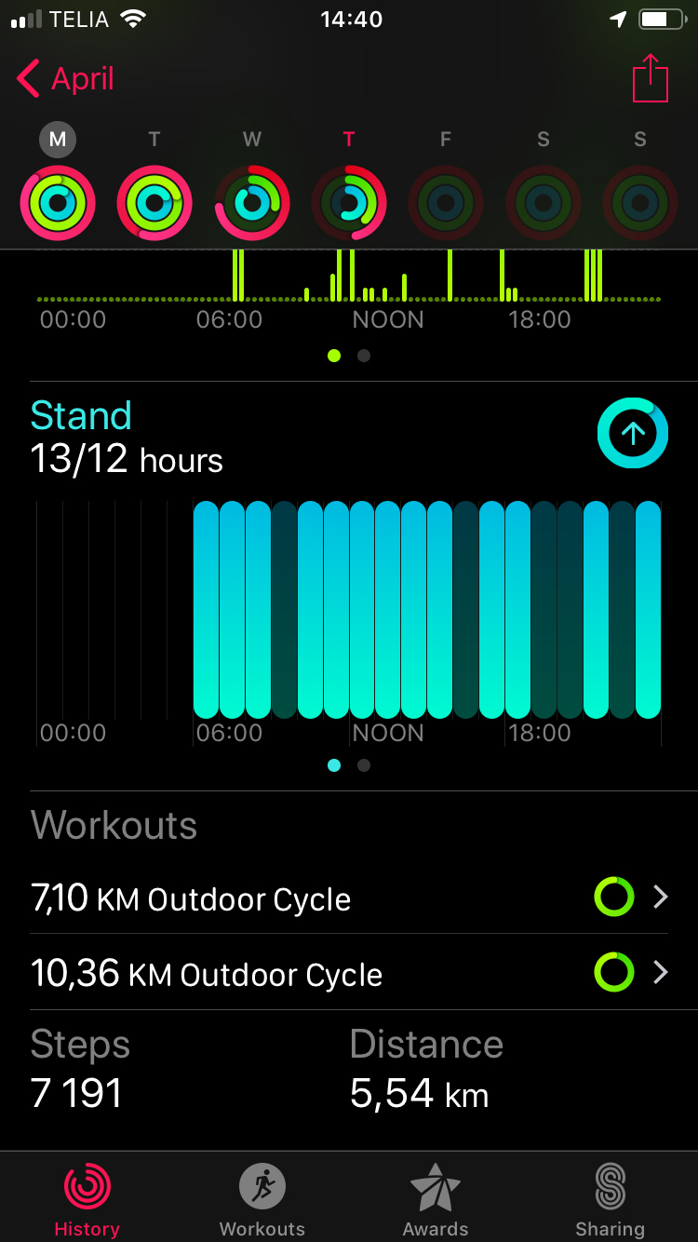
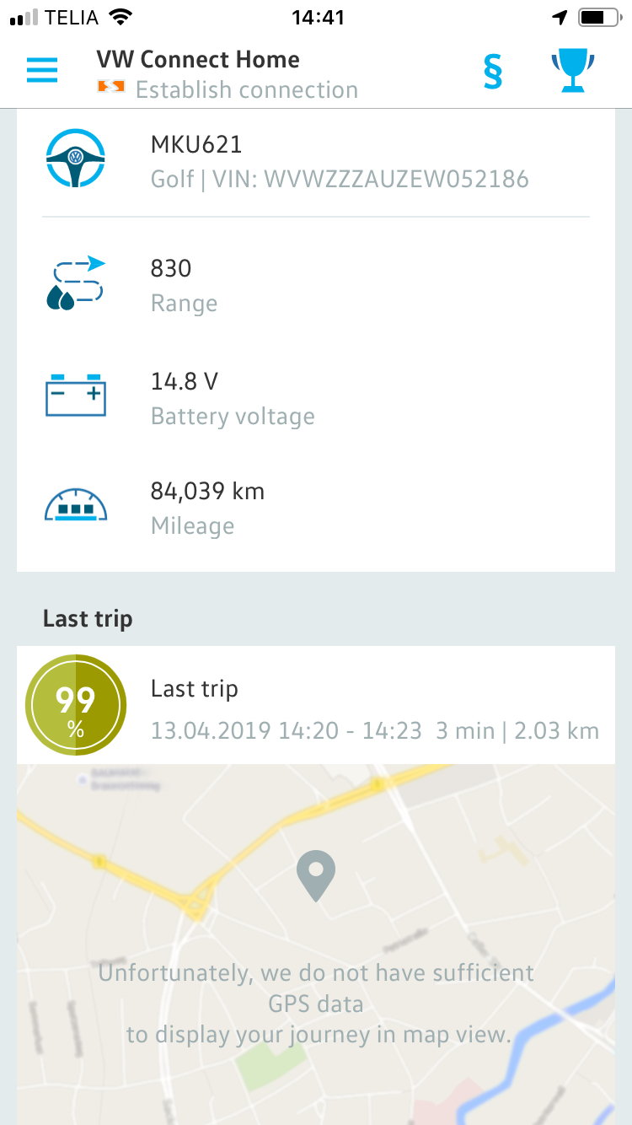
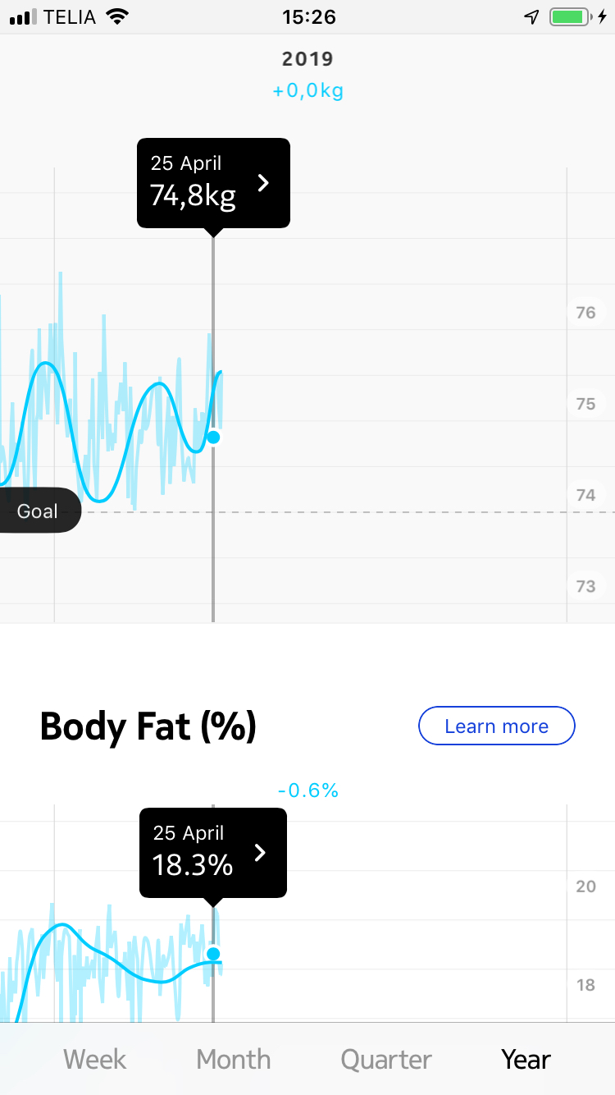
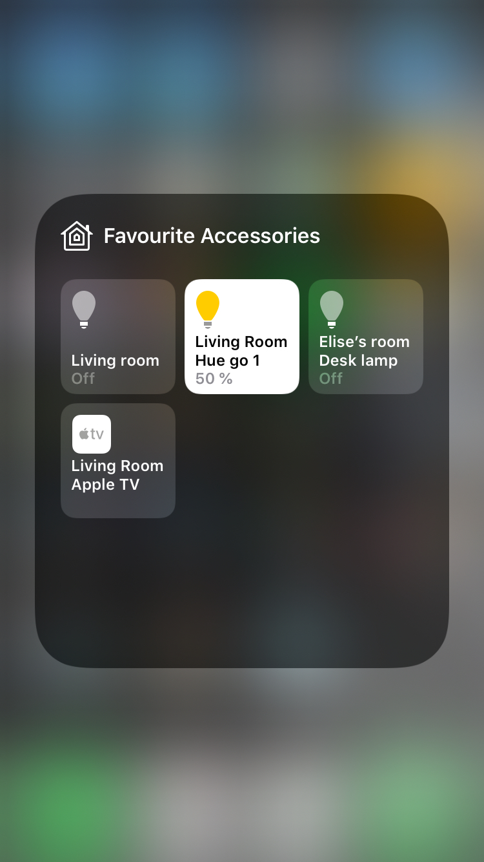
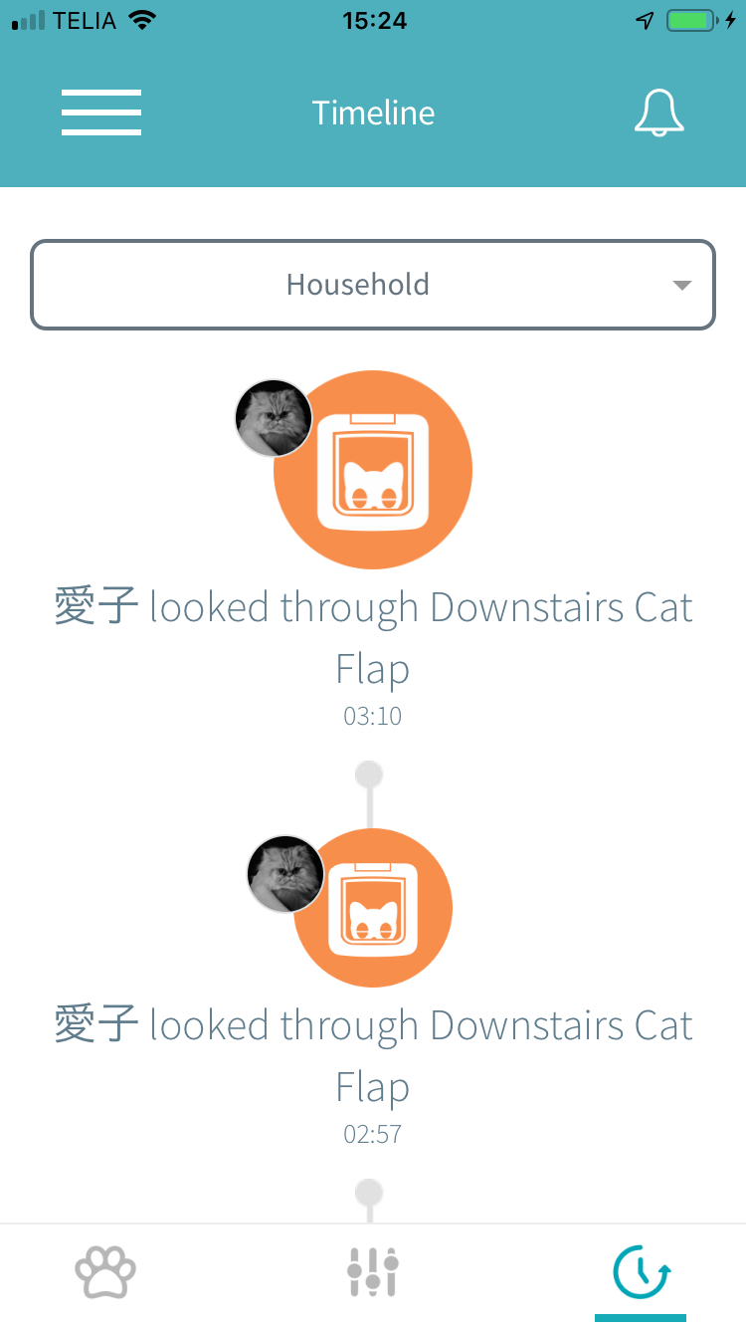
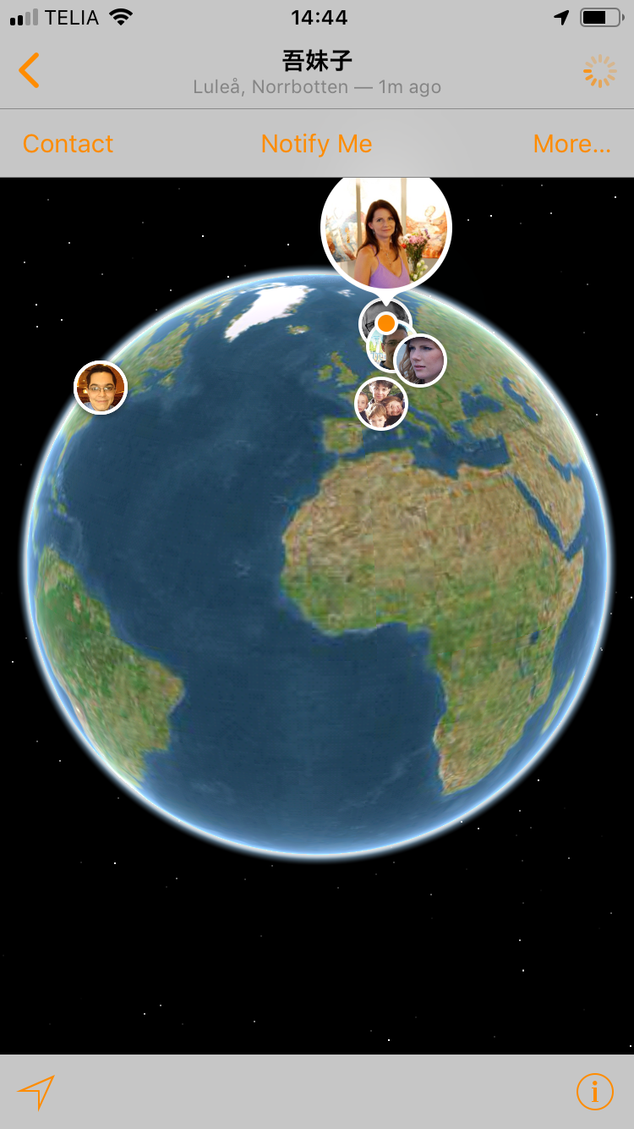

IoT in personal life

Slide 10
Why teach this course?
The Internet and IoT are parts of our life today across all society.
Developing great solutions, we insure better functions.
Enabling people to ask for great solution is essential.

Slide 11
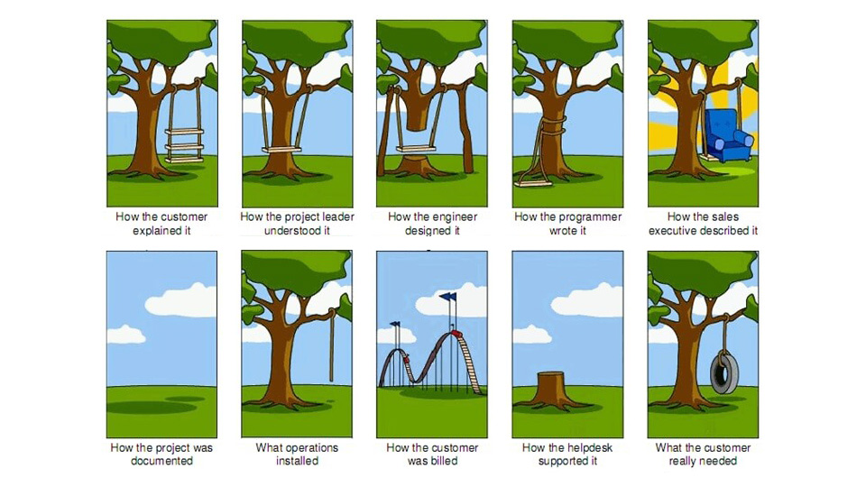
The Tree Swing Cartoon

